Slide 1
Analysis of SAT Participation Rate for the year 2019
Vaishnavi Brungi

Slide 2
Problem Statement
Many headlines were made saying that in 2019 there was a decrease in percentage of students who gave SAT compared to ACT which led to people suggesting to stop conducting SAT altogether and focus on ACT which resulted in college board forming a committee to check the same.
This analysis seeks to explore if the headlines made were true , if so what are those states and possible reasons behind that
This analysis also aims to make recommendations to the College Board for strategies to improve participation rate

Slide 3
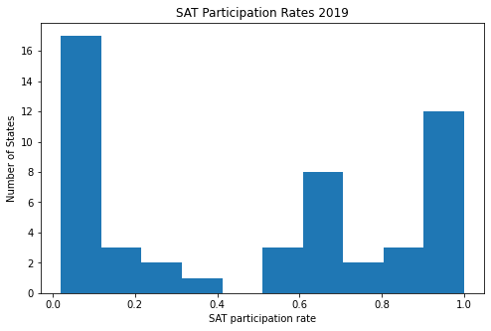

Slide 4
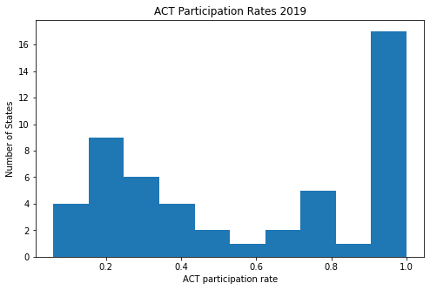

Slide 5
East and West Coast States
Mid West States

Slide 6
States with more than 50% participation Rate in SAT and ACT

Slide 8
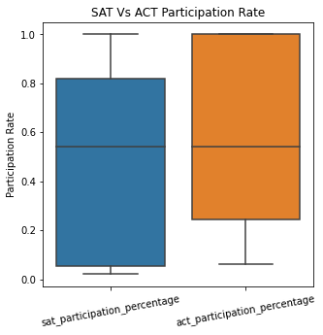

Slide 9
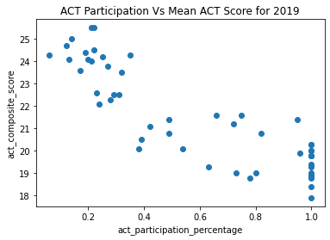
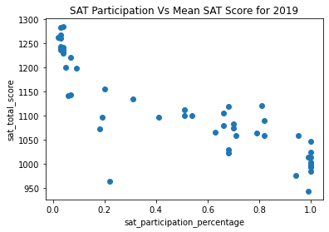

Slide 10
States with Lowest and Highest Mean SAT Score

Slide 11
States with Lowest and Highest Mean ACT Score

Slide 12
Achieving States

Slide 13
Conclusions
There are 8 states with SAT participation rate of 100% whereas there are 15 states with ACT participation rate of 100% in 2019
Least participation rate is 2% with SAT compared to ACT with participation rate of 6% in 2019.
ACT outperformed SAT in terms of participation rate
ACT and SAT participation rates are inversely proportional to their respective scores. Wisconsin, for instance, despite 3% participation, ranks 2nd in SAT mean score
East and West Coast states tend to favor the SAT, while Midwest states tend to favor the ACT.

Slide 14
Recommendations
Making exam fee free
Offering scholarship to students who take SAT
Conducting classes on test taking strategies, practice tests in schools
Making SAT mandatory in the states with low participation rate
Collaborating with coaching centers to provide free online practice and instructional videos
To give an option to take exam either through online or offline

Slide 15
Thank You

